Slide 1
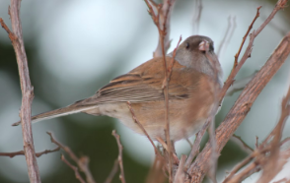
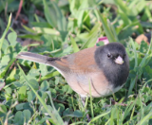
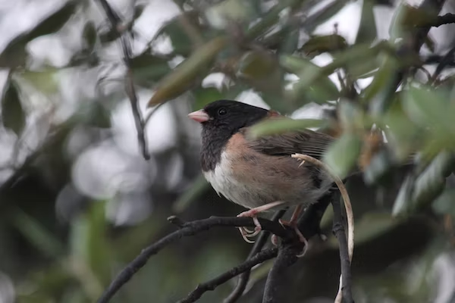
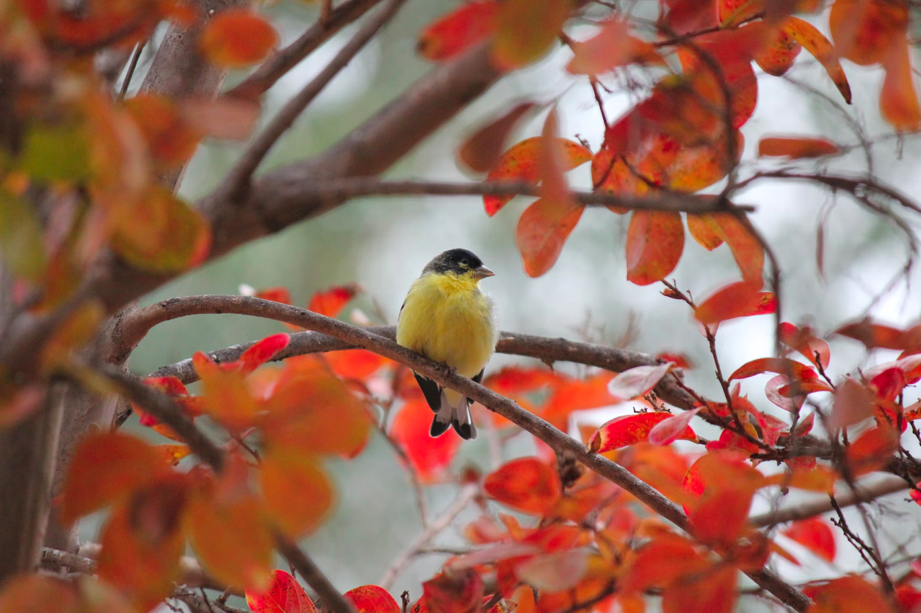
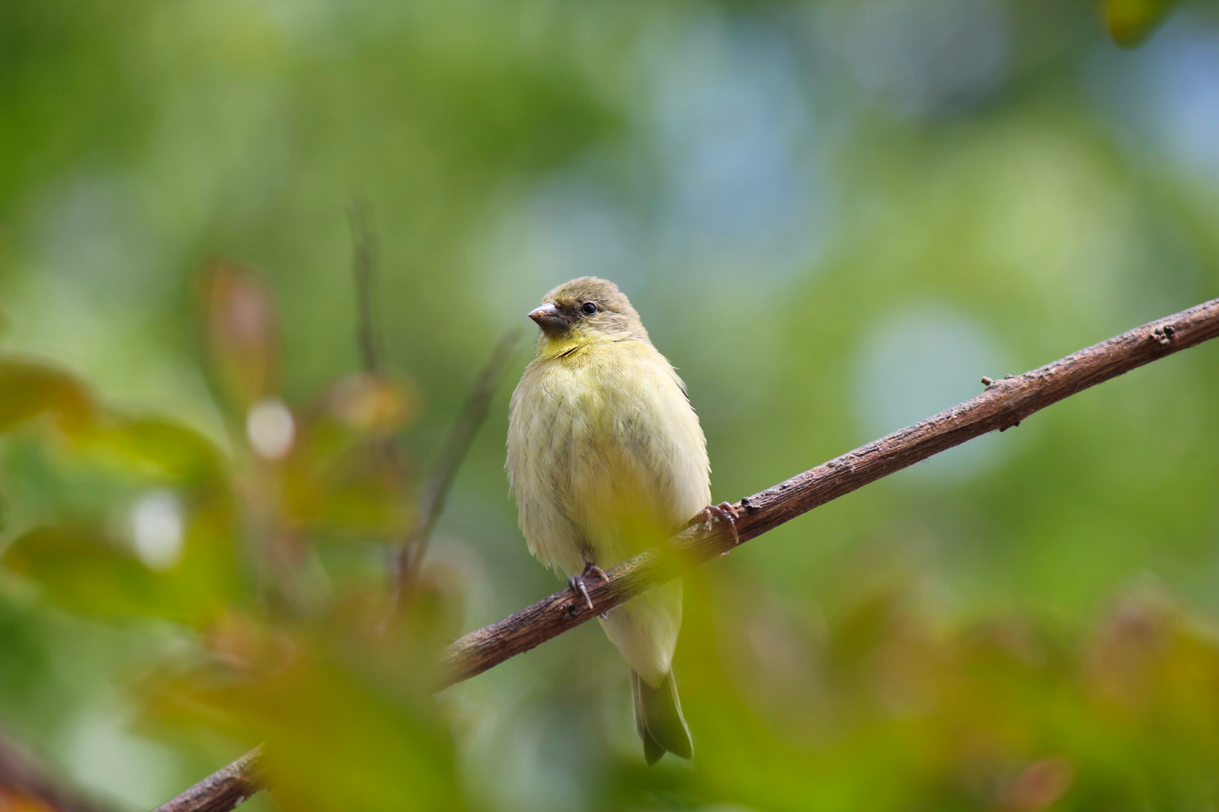
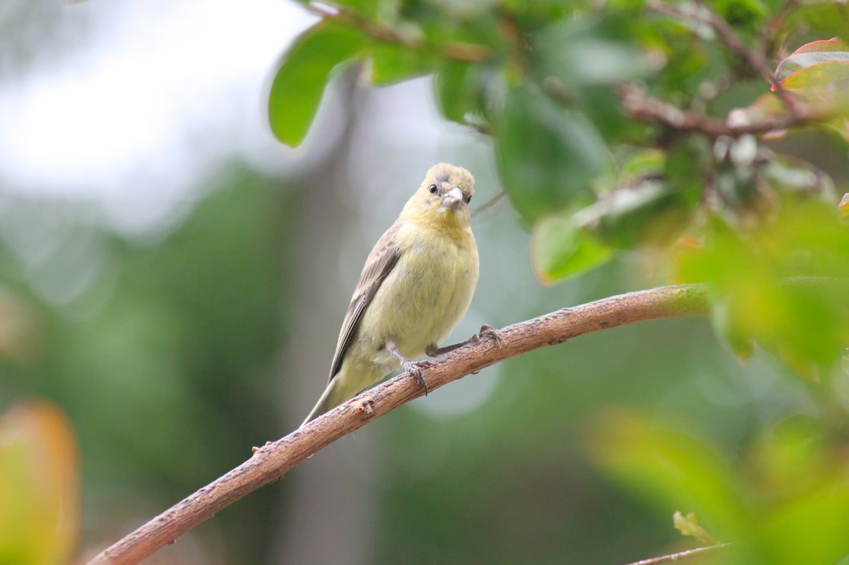
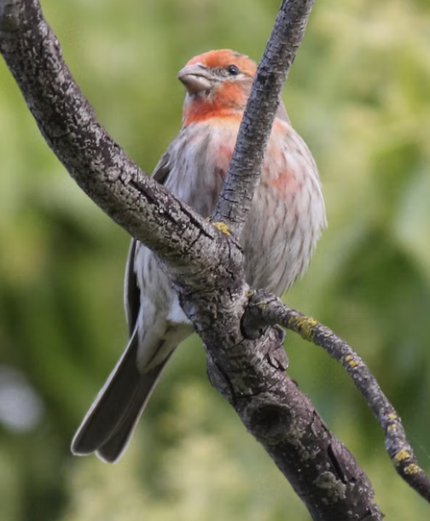
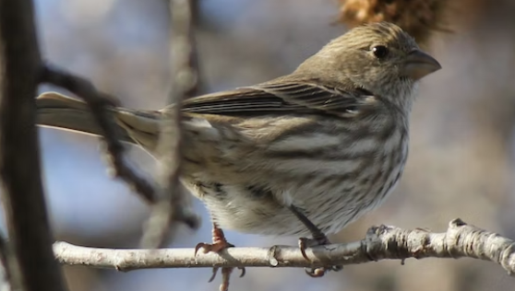
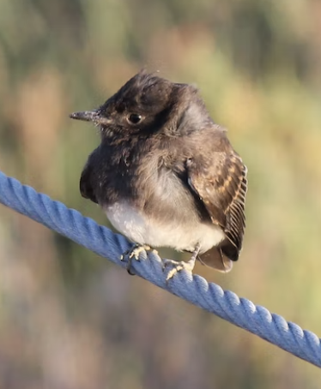
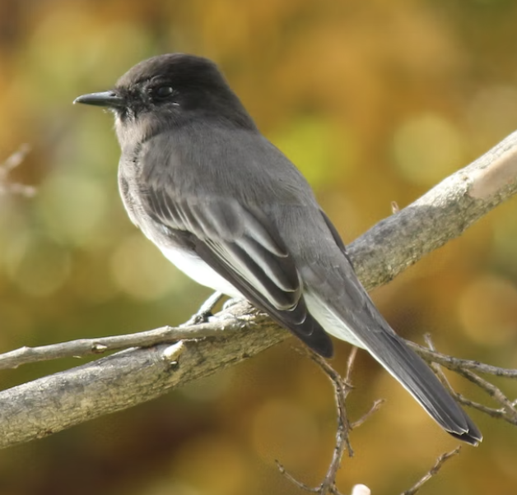
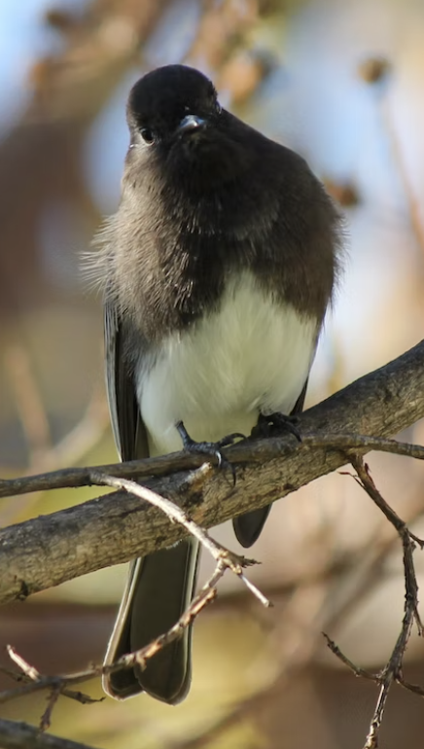
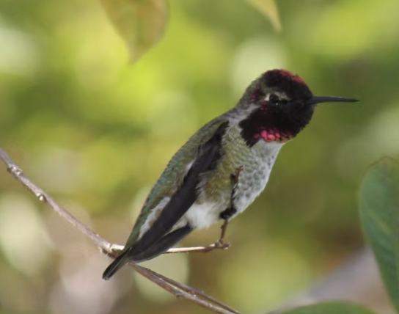
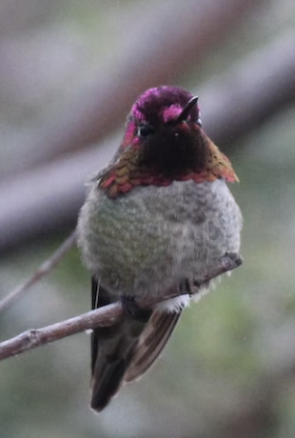
Bay Area Birds Field Guide
This guide is a not an exhaustive list. If you find any birds not in this guide, you can identify them through the Merlin app. This guide & all photos were made by Anish Lakkapragada. Birds listed in (approximate) frequency of sightings.
Bird Species
Dark-Eyed Junco
Small bird identified by black head and brownish-orange body with a white patch.
Lesser Goldfinch
Medium-sized bird with primarily yellow body (and striking black for males.)
House Finch
Medium-sized bird typically found on trees.
Striking red for males and greyish for females.
Black Phoebe
Small white-and-black bird. Hard to miss.
Anna’s Hummingbird
Buzzing creature with vibrant colors.

Slide 2
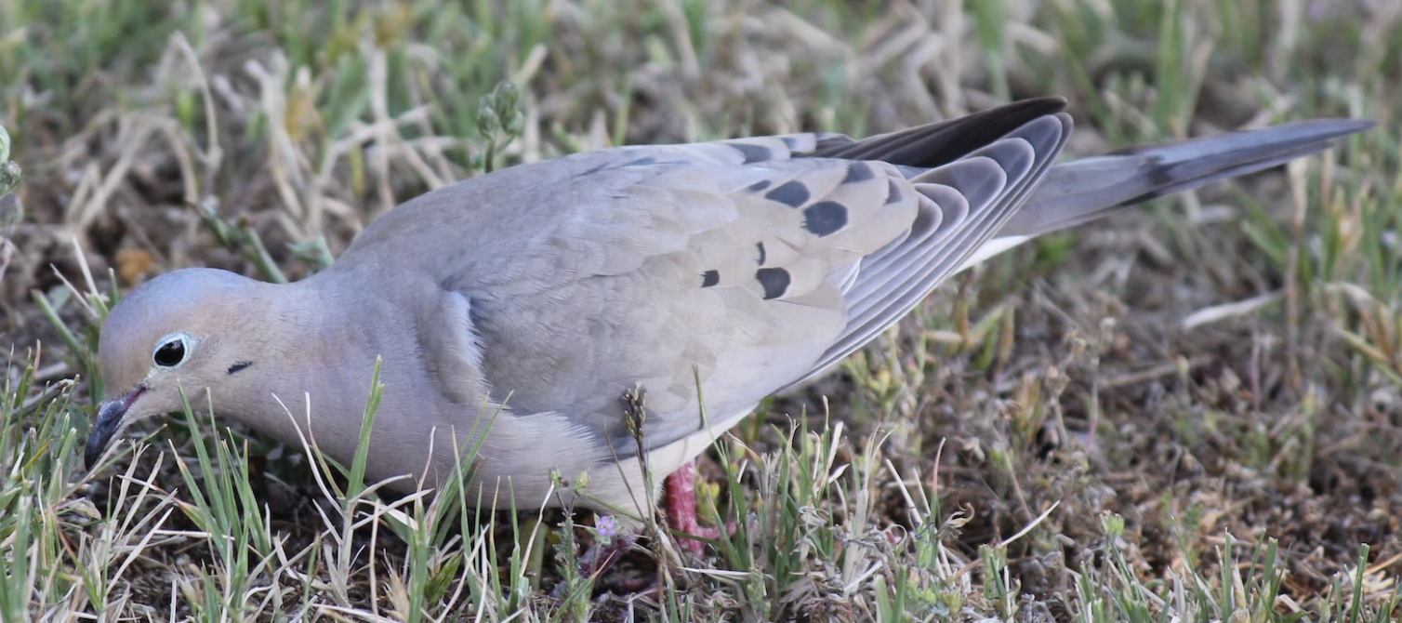
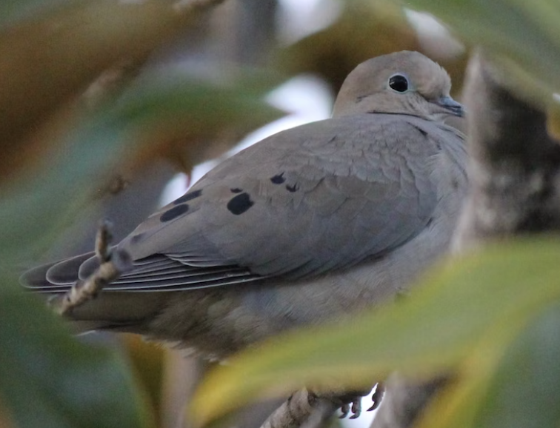
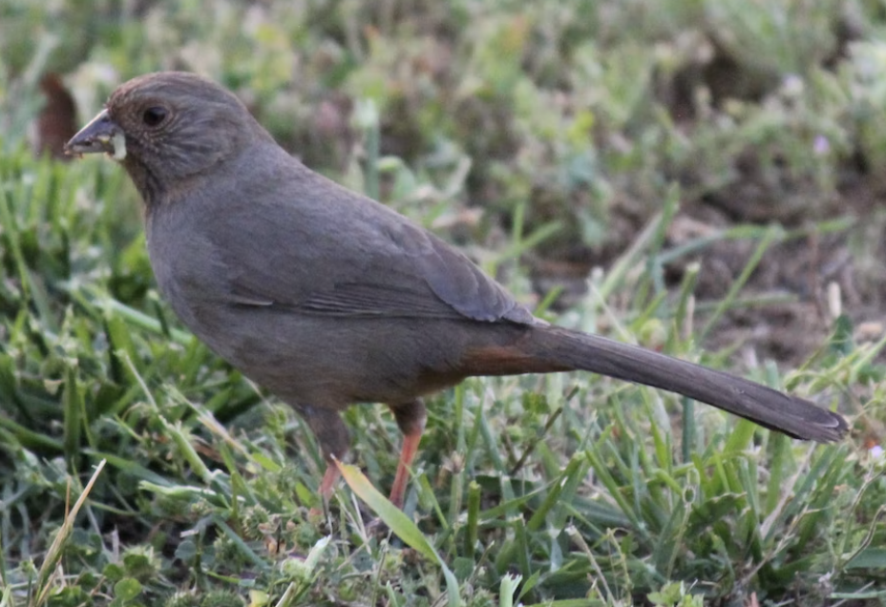
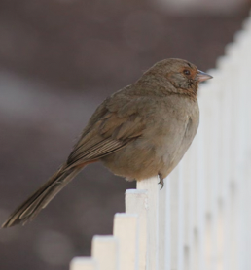
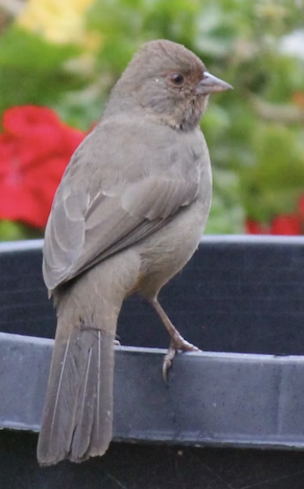
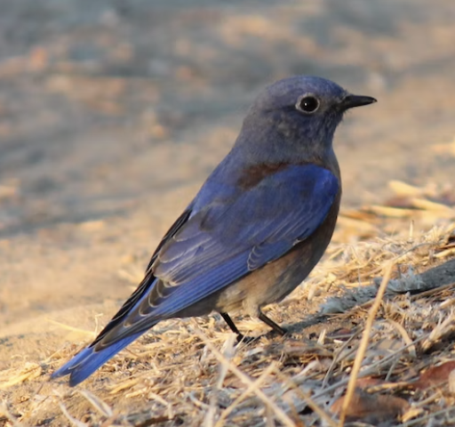
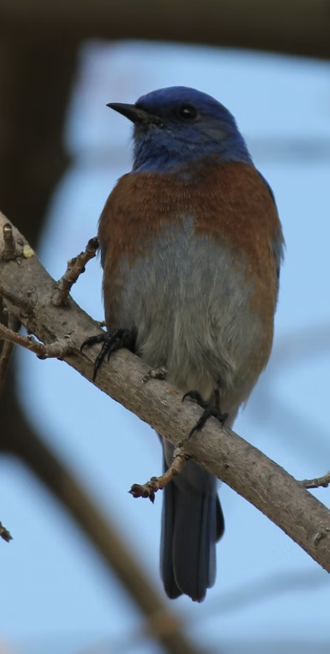
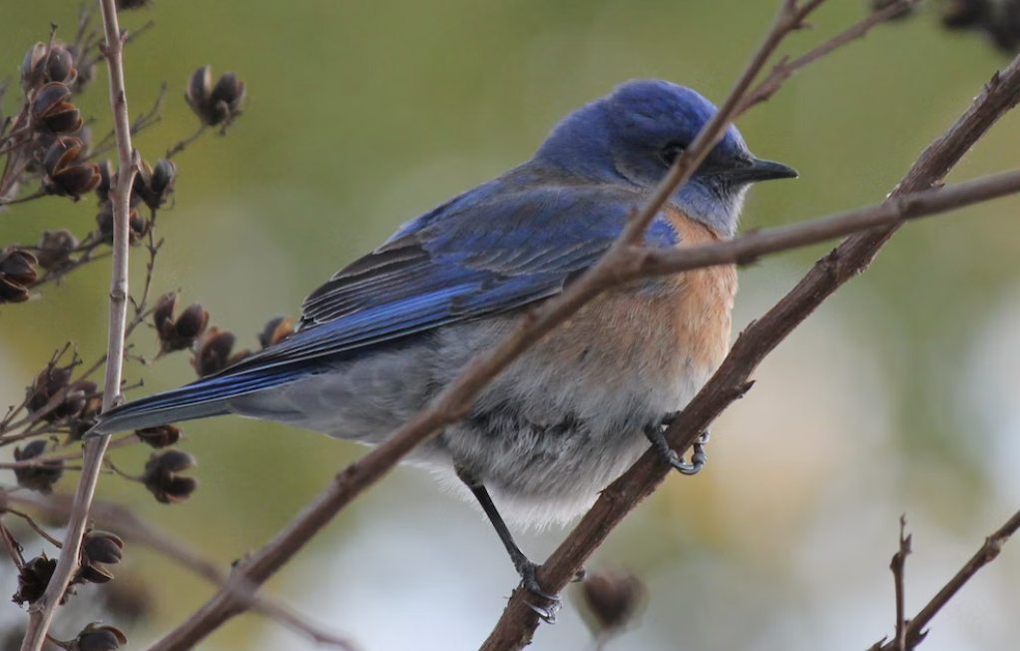
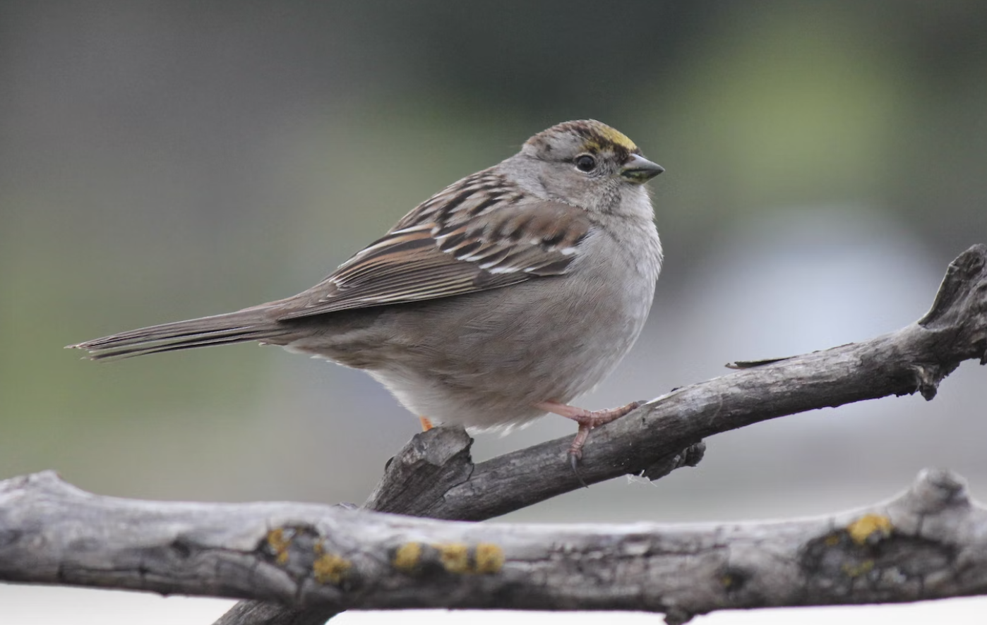
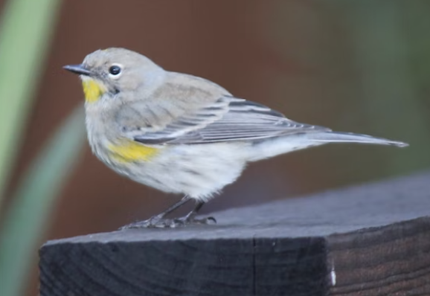
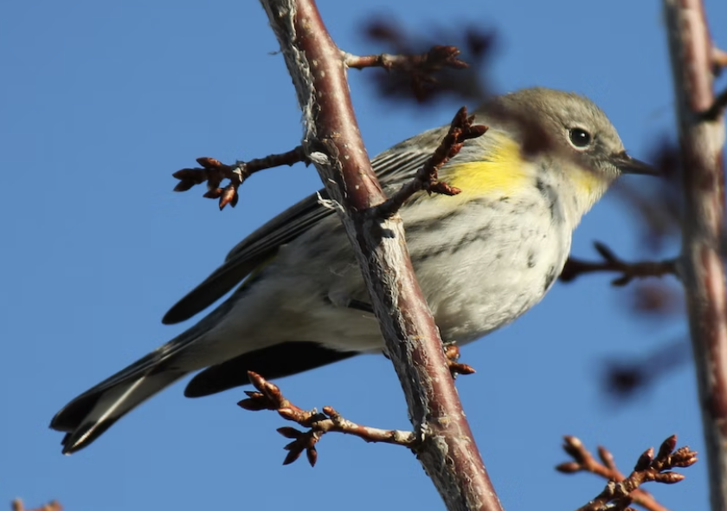
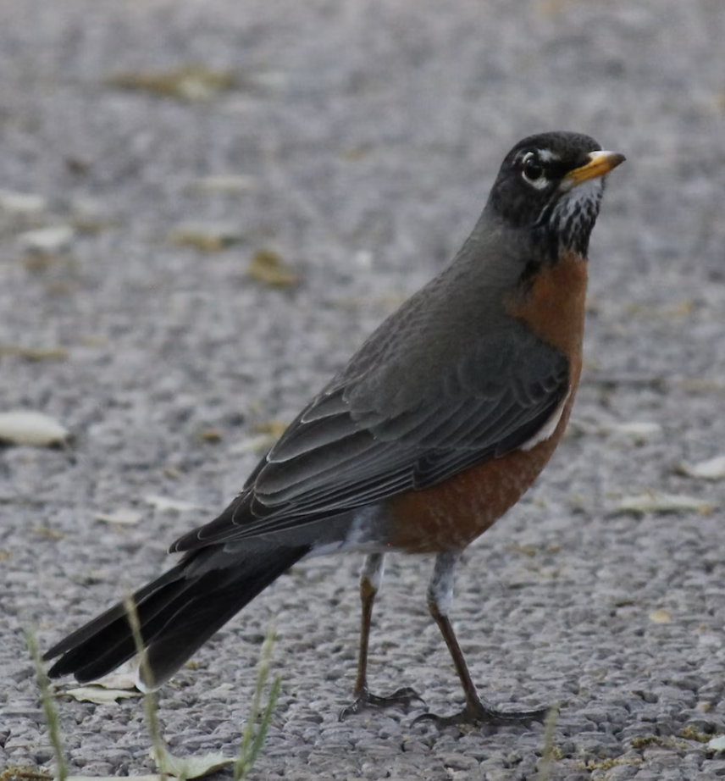
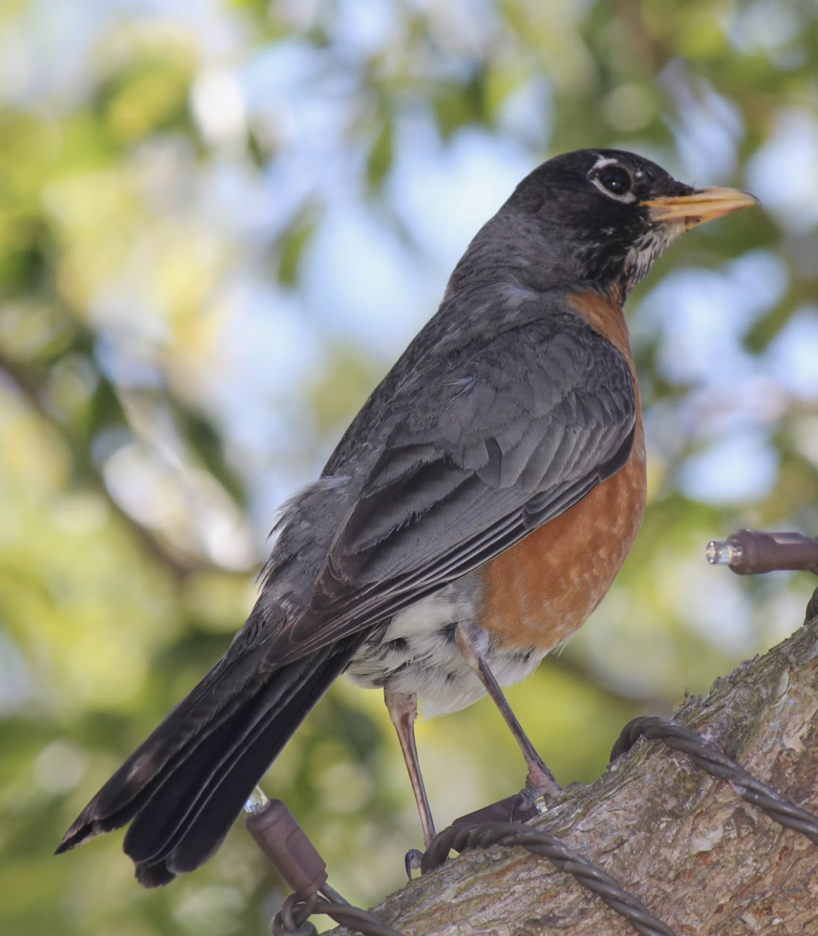
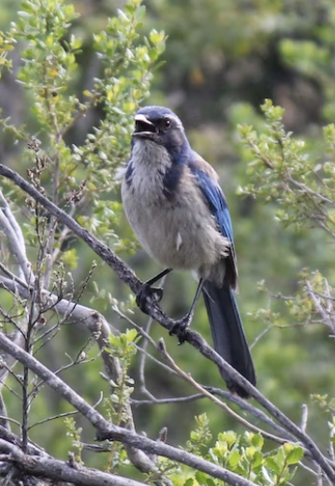
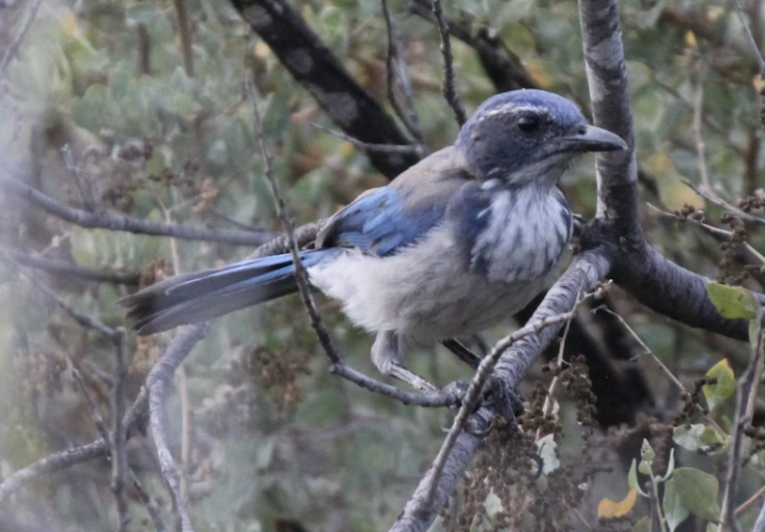
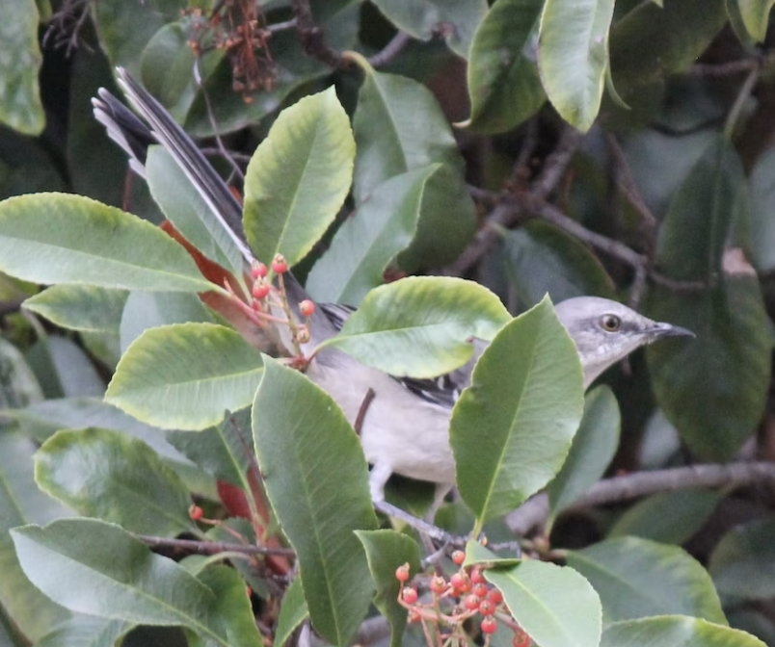
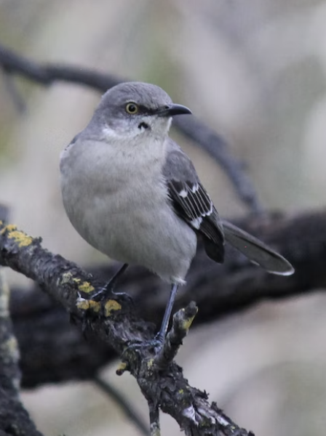
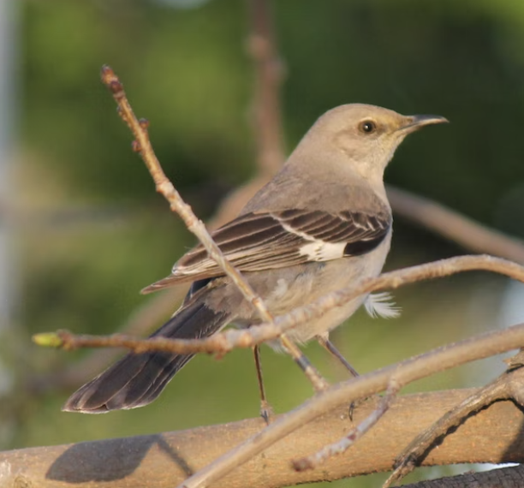
Mourning Dove
Light purple to grey bird with blue ring around eyes.
California Towhee
Extremely common bird with fully brown body.
Western Bluebird
Medium-sized bird with blue exterior and brown belly.
White/Golden Crowned Sparrow
Typically sparrow with grey body.
Color of top of head indicates species.
Yellow-Rumpled Warblers
Small-sized grey birds with yellow spots.
American Robin
Black exterior feathers with brown-orange interior.
Big eyes.
California Scrub Jay
The Blue Jay of California. Blue head and white belly.
Northern Mockingbird
Relatively large bird with grey body and sharp beak.
Remember it’s a sin To Kill a Mockingbird.
Notes:
Yellow-rumped warblers
California Scrub Jay
California towhee
White/Golden-Crowned Sparrows

